Slide 1




Slide 2

COMBINATION

Slide 3

TEST TIME ON MANEUVERING
URL: https://forms.gle/Ng9gye6z37pzzGFy8
QR CODE:

Slide 4
COMBINATIONS
Introduction
A combination is a subset of elements from a given set
Example: In a card game, we have to deal 5 cards out of the pack consisting of 52 cards. We have no interest in the order in which the 5 cards were selected. Rather, we only care which cards are present in the hand
Program: Given an array of size n, generate and print all possible combinations of r elements in array. For example, if input array is {1, 2, 3, 4} and r is 2, then output should be {1, 2}, {1, 3}, {1, 4}, {2, 3}, {2, 4} and {3, 4}.

Slide 5
COMBINATIONS
Technique-1
We create a temporary array ‘data’ which stores all outputs one by one.
Start with the first index in data, one by one fix elements at this index and recur for
remaining indexes.
Example: arr = [1, 2, 3, 4, 5] r = 3
We first fix 1 at index 0 in data then recur for remaining indexes, then we fix 2 at index 0 and recur.
Then we fix 3 and recur for remaining indexes
When number of elements in data becomes equal to r (size of a combination), we print data

Slide 6
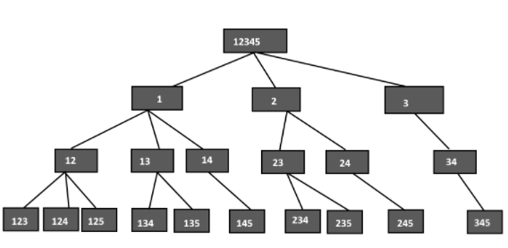
COMBINATIONS
Technique-1

Slide 7
COMBINATIONS
Technique-1: Handling Duplicates
If input array is [1 , 2, 1] and r is 2, then the program prints [1, 2] and [2, 1] as two different combinations
We can avoid duplicates by adding following to our code
1) Add code to sort the array before calling combinationUtil() in printCombination()
2) Add following lines at the end of for loop in combinationUtil()

Slide 8
COMBINATIONS
import java.io.*; public class EthCode { static void combinationUtil(int arr[], int data[], int start,int end, int index, int r) { if (index == r) { for (int j=0; j<r; j++) System.out.print(data[j]+" "); System.out.println(""); return; } for (int i=start; i<=end && end-i+1 >= r-index; i++){ data[index] = arr[i]; combinationUtil(arr, data, i+1, end, index+1, r); } } | static void printCombination(int arr[], int n, int r) { combinationUtil(arr, data, 0, n-1, 0, r); } public static void main (String[] args) { int arr[] = {1, 2, 3, 4, 5}; int r = 3; int n = arr.length; printCombination(arr, n, r); } }

Slide 9
COMBINATIONS
Technique-2
The idea of technique-2 is similar to the subset-sum problem and is based on Pascal’s identity
We one by one consider every element of input array, and recur for two cases:
1) The element is included in current combination
(We put the element in data and increment next available index in data)
2) The element is excluded in current combination (We do not put the element and do not change index)

Slide 10
COMBINATIONS
import java.io.*; public class EthCode { static void combinationUtil(int arr[], int data[], int start,int end, int index, int r) { if (index == r) { for (int j=0; j<r; j++) System.out.print(data[j]+" "); Sytem.out.println(""); return; } for (int i=start; i<=end && end-i+1 >= r-index; i++) { data[index] = arr[i]; combinationUtil(arr, data, i+1, end, index+1, r); while (arr[i] == arr[i+1]) i++; }} | static void printCombination(int arr[], int n, int r) { int data[]=new int[r]; combinationUtil(arr, data, 0, n-1, 0, r); } public static void main (String[] args) { int arr[] = {1, 2, 3, 4, 5}; int r = 3; int n = arr.length; printCombination(arr, n, r); } }

Slide 11
COMBINATIONS
import java.io.*; public class EthCode { static void combinationUtil(int arr[], int n, int r, int index,int data[], int i) { if (index == r) { for (int j=0; j<r; j++) System.out.print(data[j]+" "); System.out.println(""); return; } if (i >= n) return; data[index] = arr[i]; combinationUtil(arr, n, r, index+1, data, i+1); combinationUtil(arr, n, r, index, data, i+1); } | static void printCombination(int arr[], int n, int r) { int data[]=new int[r]; combinationUtil(arr, n, r, 0, data, 0); } public static void main (String[] args) { int arr[] = {1, 2, 3, 4, 5}; int r = 3; int n = arr.length; printCombination(arr, n, r); } }

Slide 12




THANK YOU
+91 78150 95095
codemithra@ethnus.com
www.codemithra.com

